Slide 1

S3 Case Study Project
Group 10: Francisco Marcó
Kaloyan Andreev
Sava Vasilev
A flight management infrastructure solution

Slide 2


Agenda
Recap
New Documentation
New architecture components
Financial analysis
Demo
Shortcomings and future work
MDP
Conclusion

Slide 3
Recap

Slide 4


Our solution
IaaS to provide infrastructure to flight agencies
Allow bookings, scheduling, flight management
Manage payments and user information
Provide an easy, accessible experience to travelers and tourists

Slide 5




User Requirements Specifications
Simplify and speed up internal operations for a more efficient pipeline
Ensure customer success experience with CS tools
Save up money and time
Secure Cloud based environment

Slide 6
New Documentation

Slide 7
Manuals
User Manual
Use of TrExecutor: execute terraform scripts in AWS automatically
Use of OnlyFlights website: how to book and manage flights & account
Technical Manual
Admin EC2 and Web server
Setup database for working

Slide 8


Updates to previous documents
Design document
Included C4 model diagram
Included ERD
Soon to include UML

Slide 9
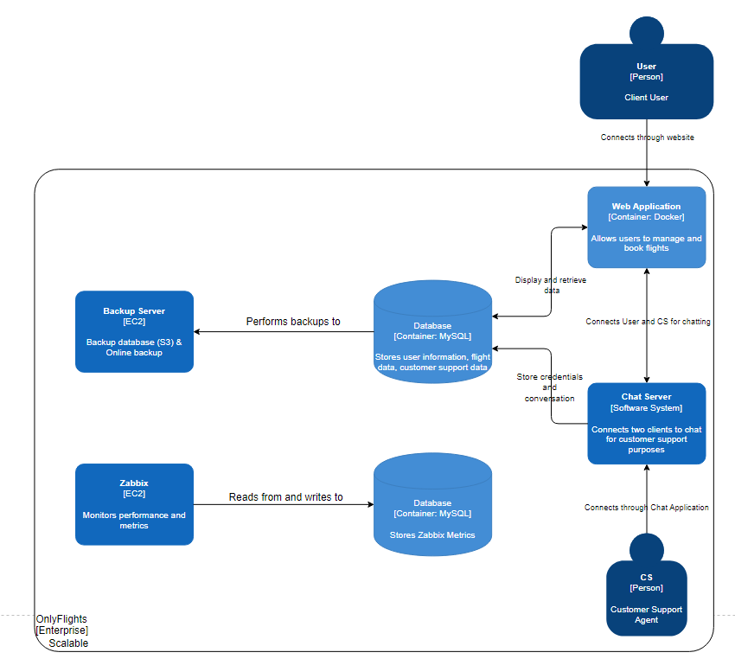

Slide 10
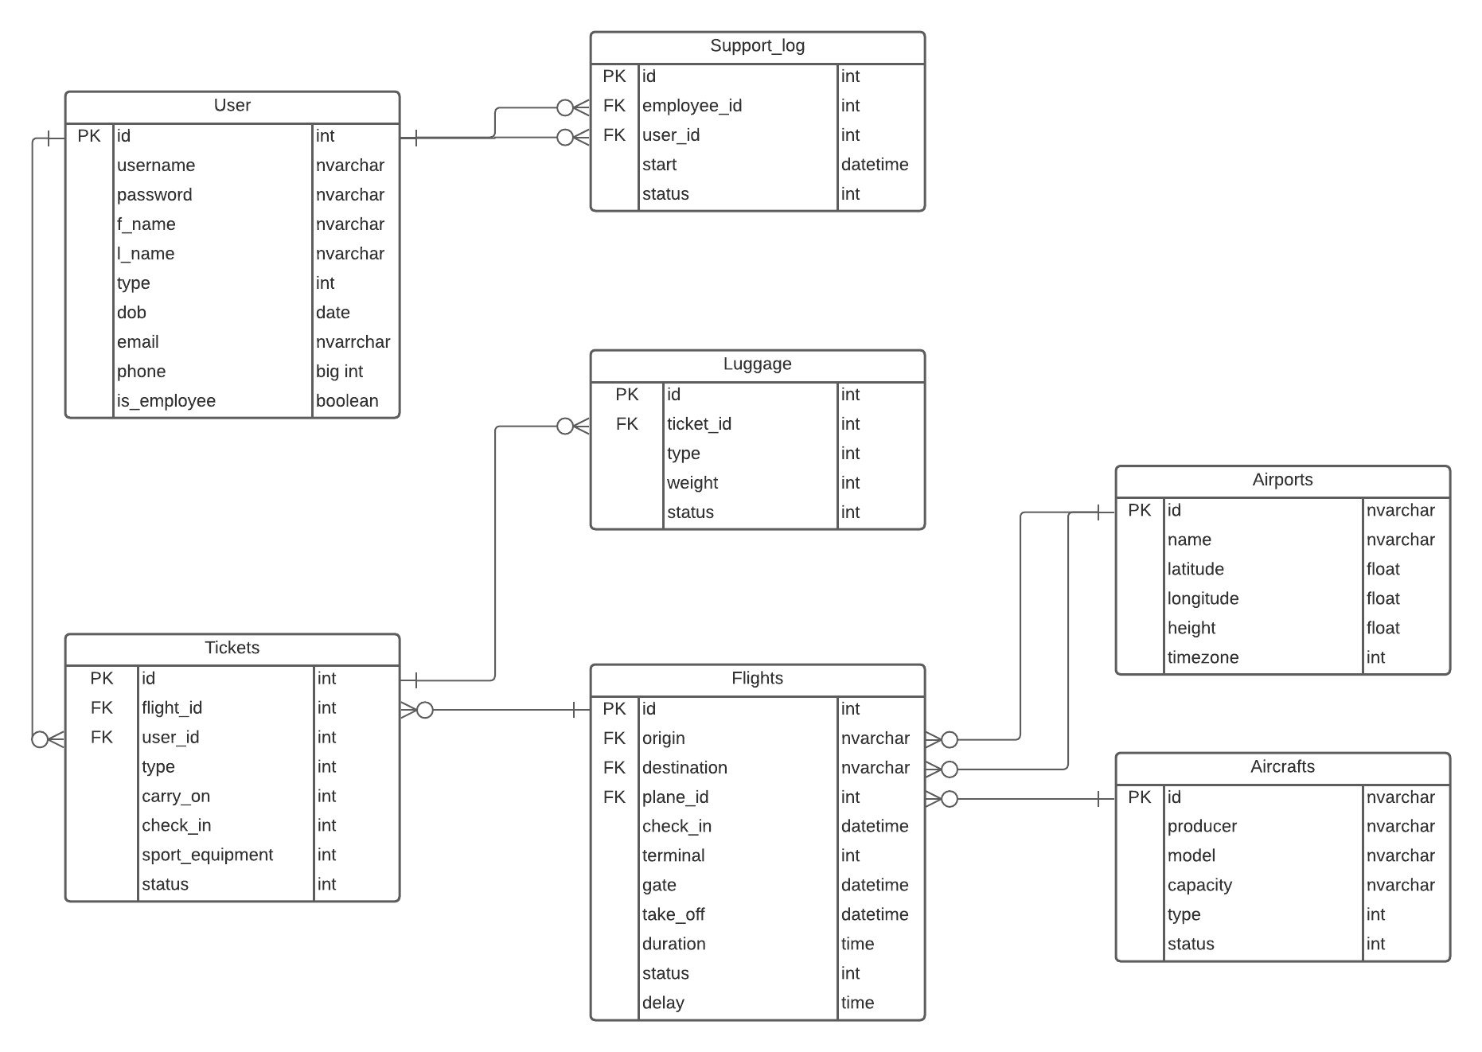

Slide 11
New Architecture Components

Slide 12


Current progress
Flask web server
Bash scripts for ansible
Automation App (TrExecutor)
Database Instance
Updated terraform scripts

Slide 13
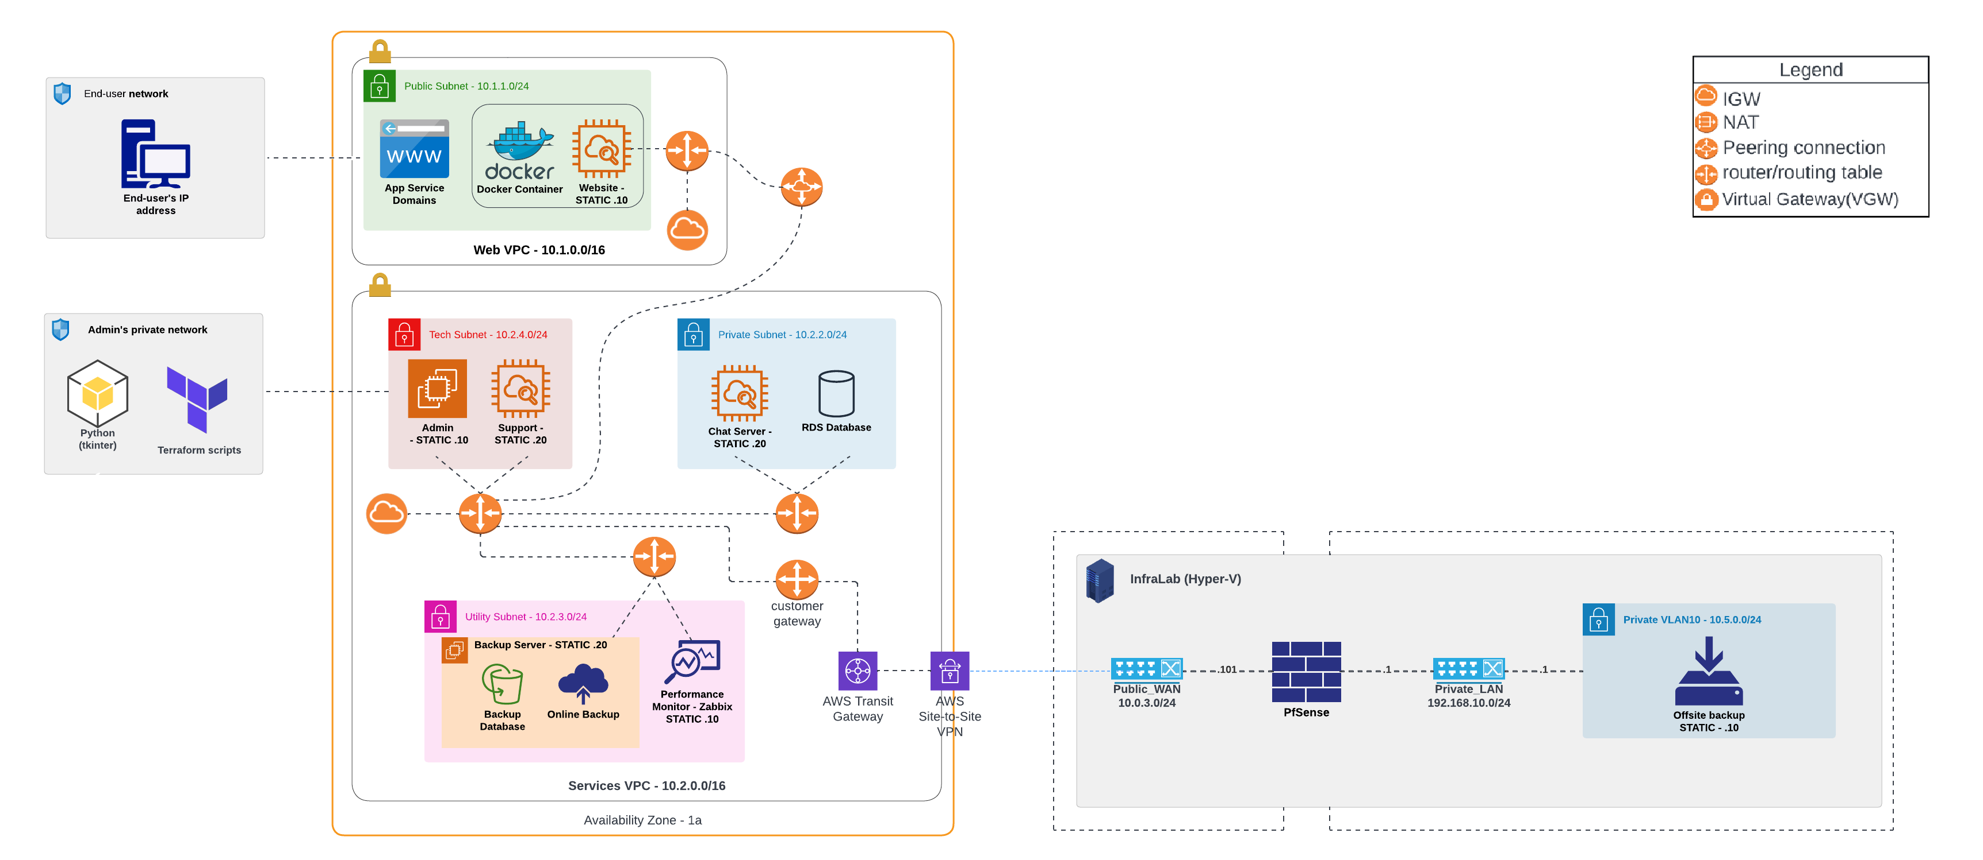

Slide 14
Financial Analysis

Slide 15
Background
Excessive spending from our group in AWS
October total $237.77
Tasked to produce an analysis and future financial strategy to reduce costs

Slide 16
Invoice breakdown
Cloudwatch: $8.13
EC2: $55.59
Registrar: $50
RDS: $26.97
VPC: $45.80

Slide 17
Preventive steps taken
Monthly budget creation
Created IAM roles to enforce policies managed by the AWS Budget
Alerts with action triggers
Stop instances and limits EC2 management to reduce costs after reaching spending limit
Stop certain inactive EC2 instances
Stop non-essential services when running at .2% CPU power (idle)

Slide 18
Demo

Slide 19
Troubleshooting, Shortcomings and Future work

Slide 20
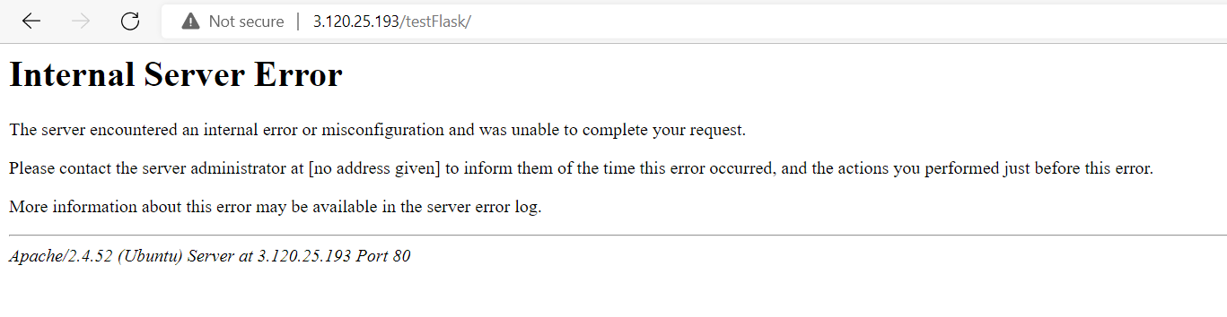
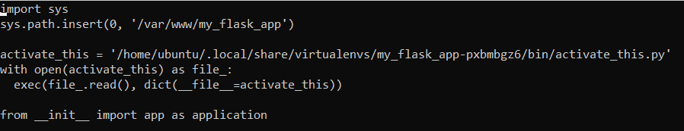
Troubleshooting

Slide 21
Shortcomings
Manage finances effectively
Manage MDP and Case Study at the same time
Develop non-essential services in time

Slide 22
Future work
Chat server
Offsite backups
Monitoring
Host Flask app on Docker container

Slide 23
MDP

Slide 24
Chosen project - IQADOT
Knowledge base for business and education primarily
Based on providing a singular answer to a question in a channel based (slack, discord) format
Client: Ali Odac
Tutor: Mikaeil Shaghelani

Slide 25
Current work – non-functional
Project plan
Design document
Group agreements
Weekly meetings, work division, communication, team info
URS
Financial Report
Comparing different cloud providers by estimating costs
Notes & minutes of every meeting

Slide 26
Current work – Functional
Automation scripts
Terraform
Network Diagram(s)
Flask web server

Slide 27
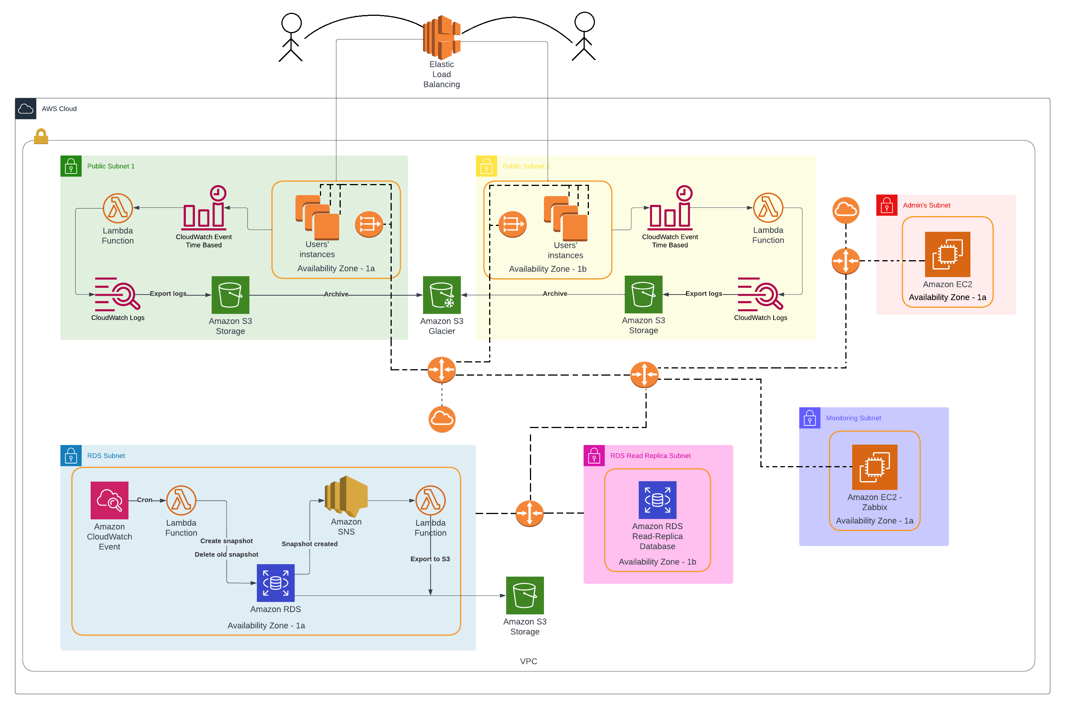
First look of the network

Slide 28
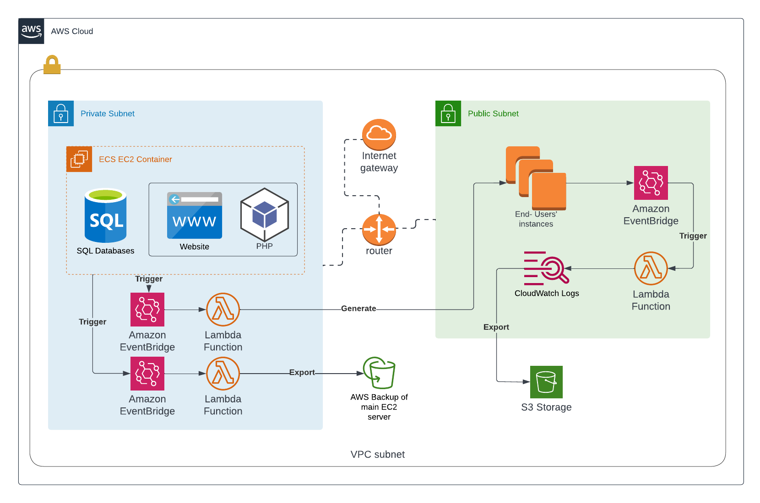
Simplified solution

Slide 29
Conclusion

